Slide 1
PROMOTION HEILWINE BAKKER
MARCH 18, 2020
The impact of rescue work on mental health and private life tasks:
How to prevent health and effectiveness in private life tasks in a high risk job

Slide 2
Goal study
This thesis aims to assess the impact of rescue work on the mental health and the functioning levels in the private lives of rescue workers.
In this research we want to develop and investigate preventive tools:
Private life task test
Mental condition training with self-management tools

Slide 3
Research questions
How can we conceptualize the private life functioning of rescue workers, and develop an adequate measure?
How does the accumulation of critical incidents and other work characteristics (workload, social support) relate to mental health in rescue workers?
How does the accumulation of critical incidents and other work characteristics (workload, social support) relate to private life functioning in rescue workers?

Slide 4
Research questions
By what process do the accumulations of critical incidents and other work characteristics influence private life functioning in rescue workers; more specifically, what is the role of mental health in this process?
Can preventive training improve the private life functioning of rescue workers and if so, which rescue workers benefit from such an intervention?

Slide 5
Life tasks
Earlier development Cantor (1991), Adler (1912)
Definition 'Life tasks' are defined as the experienced effectiveness in developing one's life and their maintenance as 'pillars of mental health' (Chapter 2). The concept consists of the following elements: social life; maintaining of mental health; household and finance; giving meaning; positivity.

Slide 6
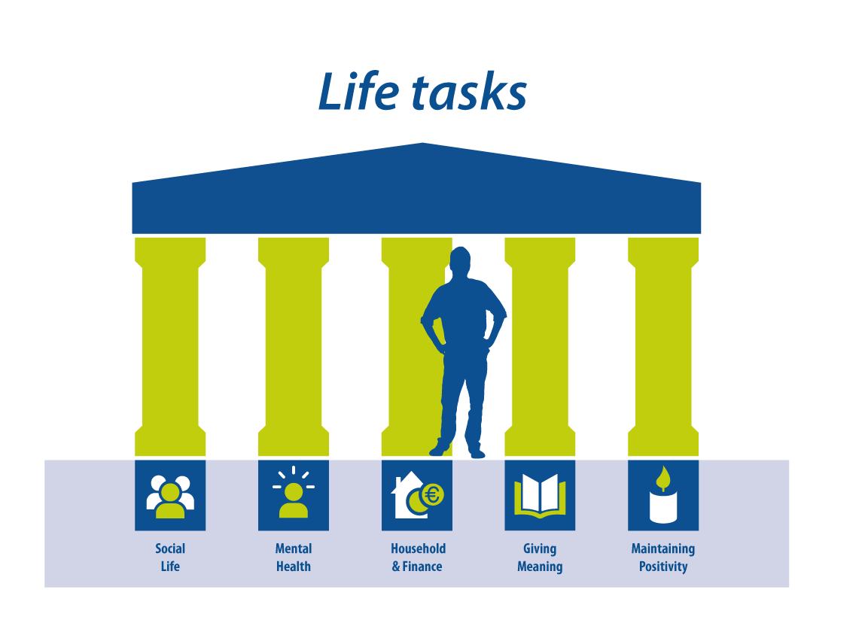
Life tasks
Social Life
Mental Health
Household & Finance
Giving Meaning
Maintaining Positivity

Slide 7
Life tasks
Development of a valid and reliable instrument the life task test. N police = 108; M 62, F 46. Age 42, 9, (SD 10, 14) N = office = 183; M 87, F 96. Age 45, 16, (SD 9, 46)

Slide 8
Life tasks
Lower perceived effectiveness in life tasks (in group policeman) is related to:
higher scores of workload
Lower support of colleagues and supervisors
Higher scores on mental health complaints and rumination about work
More negativism and somatization

Slide 9
results
Impact of critical incidents and workload on mental health and private life tasks? N = 166, M 90, F 96, gem. leeftijd 44, 55, (SD 10, 43)

Slide 10
Work-home resources (w-hr) model, diminished process, decline of resources (Brummelhuis & Bakker 2012)

Slide 11
Critical incidents overview grp 166 (1/2) Percentages of police officers (n=166) and their exposure to critical incidents. Measured with the Critical Incidents Inventory (Monnier & Hobfoll, 2002)
 | Type of incident | Never | Once | Twice | Three times or more
1 | Serious line of duty incident to self | 64,5 | 13,9 | 9 | 12,7
2 | Threat of death or serious injury (without actually getting injured) | 43,4 | 9,6 | 8,4 | 38,6
3 | Incident necessitating search or rescue involving serious risk to yourself | 75,3 | 15,1 | 4,2 | 5,4
4 | Direct exposure to extremely hazardous materials | 59,6 | 18,1 | 4,2 | 18,1
5 | Direct exposure to blood and body fluids | 58,4 | 13,9 | 6,6 | 21,1
6 | Line of duty death of a fellow rescue worker | 54,2 | 26,5 | 9,6 | 9,6
7 | Serious line of duty injury to fellow rescue worker (that did not result in death) | 74,7 | 10,2 | 5,4 | 9,6
8 | Threat of serious line of duty injury or threat of death to fellow emergency worker (that did not result in actual serious injury or death) | 42,2 | 5,4 | 7,2 | 45,2
9 | Suicide or attempted suicide by fellow emergency worker | 45,2 | 6 | 6 | 42,8
10 | Victim(s) known to the rescue worker | 36,1 | 4,8 | 5,4 | 53,6
11 | Responded to incident involving three or more deaths | 24,1 | 6 | 3,6 | 66,3
12 | Responded to incident involving one or two deaths | 48,2 | 16,9 | 10,8 | 24,1
13 | Responded to incident involving multiple serious injuries (three or more victims sustained serious injuries) | 51,8 | 9 | 11,4 | 27,7
14 | Incident involving serious injury or death to children | 63,9 | 20,5 | 10,2 | 5,4
Continued 15 - 24 >

Slide 12
Critical incidents overview grp 166 (2/2) Percentages of police officers (n=166) and their exposure to critical incidents. Measured with the Critical Incidents Inventory (Monnier & Hobfoll, 2002)
 | Type of incident | Never | Once | Twice | Three times or more
15 | Incident involving severe threat to children (that did not result in actual serious injury or death to children) | 54,8 | 3,6 | 6,6 | 34,9
16 | Incident requiring police protection while on duty | 45,8 | 8,4 | 7,2 | 38,6
17 | Verbal or physical threat by public while on duty (that did not result in police protection) | 36,1 | 8,4 | 10,2 | 45,2
18 | Failed mission after extensive effort | 28,3 | 63,9 | 6 | 1,8
19 | Critical (negative) media interest of an incident where you were involved | 60,2 | 16,3 | 6,6 | 16,9
20 | Use of deadly force by police at an incident | 68,1 | 10,8 | 10,2 | 10,8
21 | Critical equipment failure or lack of equipment in any of the above situations | 92,2 | 3 | 3 | 1,8
22 | Close contact with burned or mutilated victims | 68,7 | 14,5 | 7,2 | 9,6
23 | Removing dead body or bodies | 34,3 | 10,2 | 7,2 | 48,2
24 | Prolonged extrication of trapped victim with life-threatening injuries | 74,1 | 7,8 | 5,4 | 12,7
The sample included 166 police officers, with the average age of 44,57 years (sd = 10,44 years). In this sample, 41,6% (69) were female. The average age of female officers was 40,16 years (sd = 9,7 years). Minimum age reported was 24, maximum age 59. Mean age of male officers was 47,7 years (sd = 9,84), where the youngest officer was 23 and the oldest was 63 years. All the respondents came from the urban area and were included in 2015/2016. Important to note is that all were on sick leave and received some form of mental health counselling. Appendix: The Impact of Critical Incidents and Workload on the Functioning in Private Life of Police Officers: Does Weakened Mental Health Act as a Mediator? April 2018

Slide 13
‘Critical Incidents’ – Hans

Slide 14
‘Erosie’ – Hans

Slide 15
Results: Preventive mental health training with self-management tools
Content
Two meetings of four hours.
Tools in:
Meeting 1: Learning to handle your personal manual; recognizing your needs and stress signals and taking the right action to find relaxation again; learning to reset negative emotions and memory; and identifying your personal sources of energy in the job and your private life and learning to use them actively.
Meeting 2: Identifying aspects of the job that made them feel proud, fostering their professional growth. Colleagues and supervisors support. In the training. They developed a “personal first aid kit to maintain a good mental condition”.

Slide 16
Results: Preventive mental health training with self-management tools
Results
(N=79, 38 policeman, 41 ambulance personnel, M=49, F=30
age 40,76 SD: 9.87)
No significant improvement.
Differential analyses; the higher the score on critical incidents is, the lower the score will be on giving meaning and positivity.
Age was a negative predictor for the life task household and finance and positivity.

Slide 17
Advices prevention Recovery time, Sources of energy, support, appreciation (RESA)
Advices prevention
Incorporate preventive tools in the daily routines in the professional and the private life of the rescue workers
Recovery time, sources of energy, appreciation, acquiring more control and influence in work (e.g. work schedules), improving work organization, giving meaning and maintaining positivity (professionally and personally).
Monitor the accumulation of critical incidents and arrange recovery time.
Setting limits to time served in the front line (3 to 5 years at most for the heaviest duties).
Limiting irregular work shifts (no more night shifts over the age of 55).
Focus on what is personal significance in situations, even how small it is.
Maintaining self-care and self-management.
Be aware of one of the great pitfalls that actions and behaviors dictated by dangerous circumstances are transferred to the private life.

Slide 18
Self-management

Slide 19
Advices treatment Take care about life tasks
Advices treatment
Integrate the reinforcement of life tasks in the course of treatment. Improving the effectiveness in life tasks contributes to recovery.
The Life Task Test can transcend this issue and provide more insight into the actual functioning levels of the rescue worker.
Determine the level of erosion and functioning in life tasks before starting trauma treatment, since intensive trauma treatment may lead to even more serious disturbance of an already fragile balance.

Slide 20
Suggestions future research
Suggestions future research
The inclusion of a control group (consisting of colleagues or non-rescue workers in stressful jobs) is imperative to compare results and specific job characteristics.
The inclusion of a greater variety of rescue work occupations might also yield interesting information.
A longitudinal research on the impact of critical incidents, on mental health and private life tasks.
Also a longitudinal research on the results of a preventive training.

